Slide 1
IT2402-Free and Open Source Software Solutions
INTRODUCTION

Slide 2
Free Software
Free Software Definition
( By Richard Stallman, adopted by the Free Software Foundation(FSF))
“Free Software is a matter of liberty not price, and it upholds Four Essential Freedoms”
Freedom 0
The freedom to run the program as you wish, for any purpose
Freedom 1
The freedom to study how the program works, and change it so it does your computing as you wish
Freedom 2
The freedom to redistribute copies so you can help others
Freedom 3
The freedom to distribute copies of your modified versions to others

Slide 3
Freeware
Freeware refers to software that can use without incurring any costs
Often shared without the source code; but may share with the source code
Offers minimal freedom to the end user
Modification or redistribution needs permission from the author
Ex: Adobe Reader
Skype

Slide 4
Freemium vs. Shareware
Both are kind of freeware which market with the intention of encouraging users to buy a more capable version.
Freemium offers at no cost, but need to pay money for additional features (premium versions).
Shareware are available without any initial cost, but to a certain cost-free period; thereafter, user is required to pay for continued use.

Slide 5
Open Source Software
What is source code?
Source code is a set of human readable instructions written using a programming language
Ex:
#include <iostream> int main() {
cout<<"Hello World!\n";
}
Source code vs. binary code
Source code is not machine readable
Source code can be compiled to machine code; which is machine readable
Machine code is also called Program Binary
Ex:
0000160 0006 0000 0012 0000 0004 0000 0014 0000 0000170 0003 0000 4e47 0055 ac29 394b 26bf 01f1 0000180 e396 f820 3c24 f98c 8c5a 8909 0002 0000

Slide 6
Open Source Software Cont..
Very close to ‘free software’ but not identical to it.
Source code is available to users under a copyright
Freely allowed to re-distribute the software
Users can modify the source code to eliminate bugs and improve the software
Open source software can either be free of cost or chargeable.

Slide 7
Open Source vs. Closed Source
Open Source | Closed source
Source code is available to view and modify | source code is not released to the public
Highly flexible and free to change the software without restriction | Source code is not shared; therefore no changes can be done
Maintained by online user community | software is usually maintained by a team who produces the product
Low revel of support compared to closed source software | Excellent ongoing services and support
Low usability | Often Highly usable

Slide 8
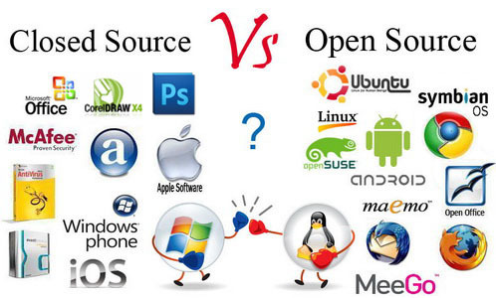

Slide 9
FOSS
What is FOSS?
FOSS or Free and Open Source Software, is software which has the freedom to share its source code
The freedom to run the program for any purpose
The freedom to study and modify the program (need the source code to be opened)
The freedom to copy the program
The freedom to improve the program and release to the public (need the source code to be opened)

Slide 10
FOSS Business Model
To whom?
Companies whose business centered on development of open source software
Why?
To make money providing software that is by definition licensed free of charge
How?
Selling FOSS for low cost
Providing FOSS with proprietary extensions (plugins, add-ons)
Providing free FOSS with charged services (training, support)
Dual licensing
Total free version (individual users)
Another version for money (companies)
Donations (for developers)

Slide 11
Software License
Public domain
Most permissive type of software license
No restrictions for using and modifying the software (grants all rights)
Should have to make sure it’s secure before adding it to the own codebase
Permissive
Apache/BSD/MIT License
Most popular type with free and open source software
Minimal requirements about how the software can be modified or redistributed

Slide 12
Software License Cont..
LGPL
The GNU Lesser General Public License
Cab be used to link to open source libraries in your software
The software linked with an LGPL-licensed library can be released under any other license (allows prioritization)
Need to use LGPL license if the library is modified or copied
Copyleft
reciprocal / restrictive licenses
Free to distribute copies and modified versions of the original work
Forbids prioritization
Proprietary
The most restrictive ( all rights are reserved)
Any work may not be modified or redistributed

Slide 13
Exercises
Discuss why does FOSS matter to you as a IT student
Create a list of software that you often use. What kind of software they are? Freeware/Free Software/FOSS?
Select the proprietary software products from the list you have created. Find FOSS equivalent for each product and compare.
Compare the different types of software licenses with examples

